Slide 1
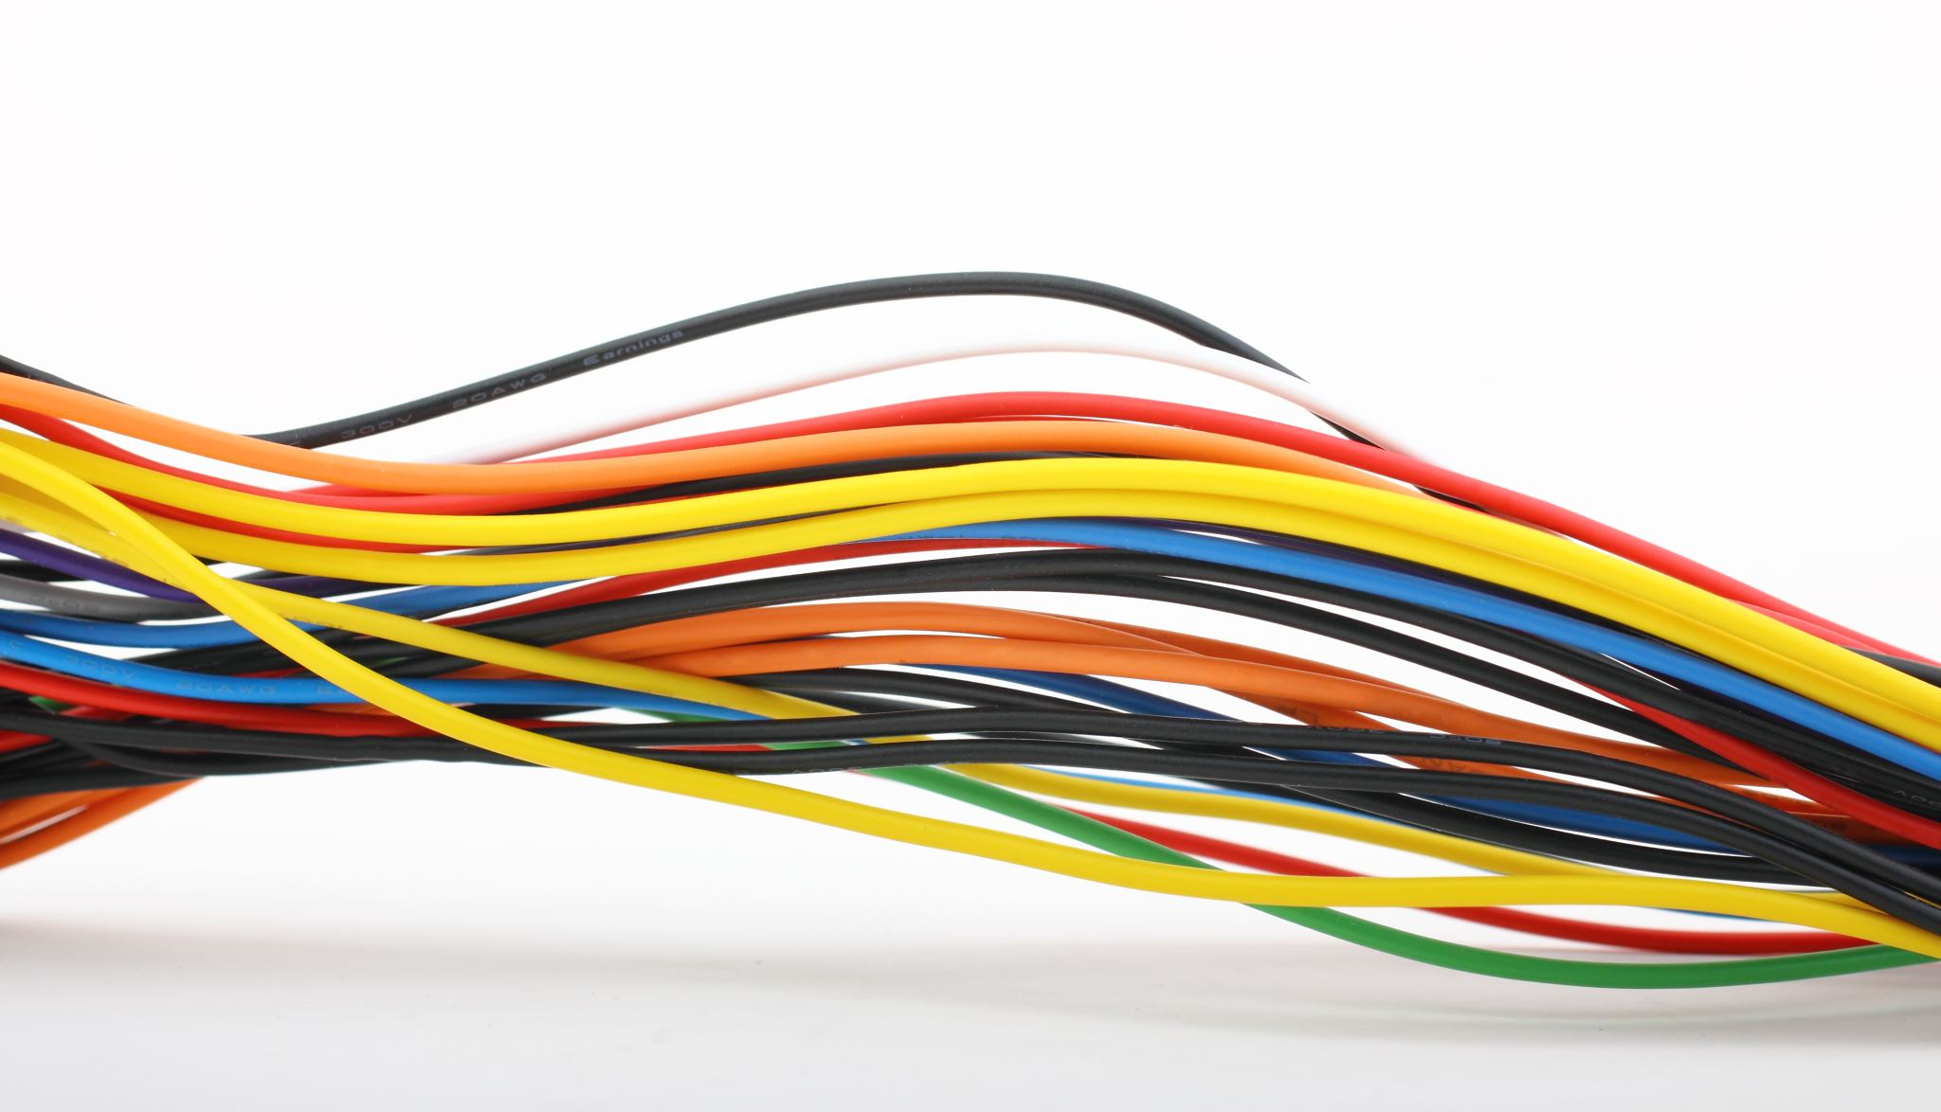
How to tip RJ45(Cat5) Cable

Slide 2
Proper Wiring For Ethernet Cables
Cables can transmit information along their length. To actually get that information where it needs to go, you need to make the right connections to an RJ45 connector.
Your cable run needs to terminate into a connector, and that connector needs a jack or NIC to plug into.
Registered Jack 45 (RJ45) is a standard type of physical connector for network cables. RJ45 connectors are commonly seen with Ethernet cables and networks.
Modern Ethernet cables feature a small plastic plug on each end of the cable. That plug is inserted into RJ45 jacks on Ethernet devices. The term “plug” refers to the cable or “male” end of the connection while the term “jack” refers to the port or “female” end.

Slide 3
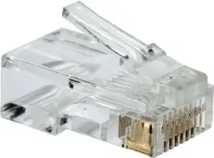
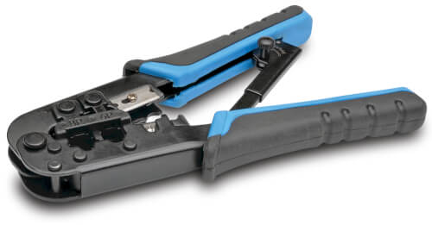
RJ45 plugs feature eight (8) pins to which the 8 wire strands of a Cat5 cable enter. Each plug has eight positions, spaced about 1mm apart. Individual wires are inserted and are set in place using special cable crimping tools.

Slide 4
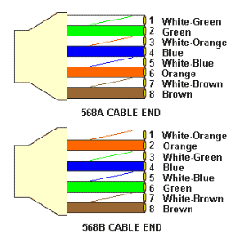
T568A or T568B Wiring Standard
T568A and T568B are the two color codes used for wiring eight-position modular plugs. The only difference between the two color codes is that the orange and green pairs are interchanged.
There are no transmission differences between T568A and T568B cabling schemes. North America’s preference is for T568B. Both ends must use the same standard. It makes no difference to the transmission characteristics of data.

Slide 5
How to tip an RJ45 cable in 6 steps
Strip away the sheath about 1 inch from the end
Untangle and straighten the wires
Arrange the wires in the correct order (T56B)
Cut the wires into an even line and fit them into the connector
Stick the connector into the crimping part of the tool and squeeze the small pins into the wires and secure the connector.
Repeat on other side and test the cable for connectivity

Slide 6
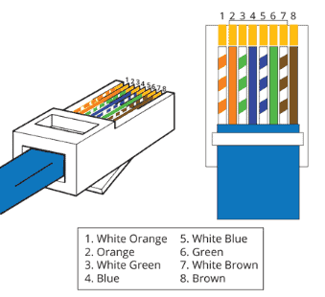
When looking at the RJ45 tip, the clip should be on the back, the T56B color scheme should be visible, and all ends of the wires should all the way inserted and crimped down by the coper pins. Follow the layout shown.

Slide 7

Questions

